Slide 1
Operating the Australian Synchrotron during the Pandemic
Actions taken and lessons learned
Mike Lafky
Manager, Accelerator Operations
lafkym@ansto.gov.au

Slide 2
A timeline of Covid-19 in Melbourne
1st Wave : March 2020 – May 2020
2nd Wave : June 2020 – October 2020
Return to Normal(ish) : November 2020 – June 2021
Delta : July 2021 –
Notes:
Thanks Violetta for that introduction.
Greetings to everyone from the most locked down city on Earth. And to answer your first question it’s just before 1 AM here.
For my talk I’ll be focusing on the Synchrotron’s response to four distinct periods of the Covid-19 outbreak in Melbourne.
The Victorian government’s response to the Covid outbreak during each of these phases, and the operations team had to respond to the new requirements.

Slide 3
Australian Synchrotron Essential Facts
3 GeV 3rd Generation Synchrotron Light Source
5000 hours user-beam annually
User-beam 0800 Tuesday to 0800 Sunday or Monday (24/5 or 24/6)
10 operational beamlines, 7 under construction
5000+ users annually pre-covid
Notes:
So a little bit about the Australian Synchrotron:
We are a 3 GeV 3rd Generation Light Source operating since 2006.
During normal operations we run 24 hours per/day 5 or 6 days/week – Mondays are either Machine Studies or Maintenance days.
We schedule 5000 hours of user beam each year and usually deliver greater than 99%
Pre-Covid we had more than 5000 users per year.
During FY21, the first full fiscal year of the Covid Pandemic, that dropped by almost 30%.

Slide 4
The Operator Job
Keep the accelerator running
After hours beamline/user assistance
Fulfill a number of mandatory WHS requirements:
Building Wardens (emergency response, evacuations, etc…)
First Aid
And regulatory requirements:
Radiation Worker Trained
Notes:
The most important part of the operator job is just keeping the machine running
Operators respond to beamline faults on nights and weekends
They fulfill mandatory workplace health and safety requirements as trained building wardens and first aid providers
They are trained radiation workers which meets our regulatory requirements

Slide 5
The First Wave: March 2020 - May 2020

Slide 6
Before Lockdown - Pandemic Rules for Operators
In General:
Social distancing
Contact tracing
Non-ops restricted from the control room
Limit based on government advice
1 operator in the control room
1 workstation for your shift
On Beamline Callouts:
Contact tracing
Users wait outside cabins
Mandatory PPE
1 operator per callout
Picture from March 2020
Notes:
By March Covid-19 had been in Australia for at least six weeks.
The initial government response was slow, so we had to be proactive.
Ops developed a set of rules for behaviour during the pandemic
In addition to social distancing operators recorded one on one interactions with others
We restricted non-operators from the control room, and only one operator worked in the control room at a time.
To promote social distancing we limited the control room to one operator, with another staffed in the adjacent office.
On beamline callouts we limited to one operator per callout whenever possible with mandatory PPE, required the users to wait outside their cabins and took down their names for the log.
All of this was before the government declared any restrictions.

Slide 7
Daily New Cases in Victoria: 01/03-31/05
Source: Victoria DHHS
Restrictions implemented
Notes:
Finally on 23rd March, with new cases rising, the government of Victoria declared the first lockdown

Slide 8
1st Wave Lockdown Restrictions
AS operates “on demand” for the first time in history
Short notice (<24 hours) flexibility required
Deliver only 104 hours of user beam out of 680 originally scheduled (15%)
Most staff (>2/3) work from home
Ops work from home when no beam required
AS allowed to operate for:
Workers allowed on site only for:
Covid Research
National Security
Work essential to safety or maintenance
Supporting allowed research
Notes:
The first lockdown was very sudden – we had less than one day’s notice.
The government permitted only Covid Research and National Security research.
And workers were only allowed on site for two reasons: essential maintenance work or as required to support allowed research.
Restrictions on interstate and international travel meant nearly all of our users would be coming from Victoria, or were sending samples for remote work.
Because of the severely reduced users and the restrictions on research, management decided to turn off the accelerators when not needed, so for the first time since commissioning we turned off the machine overnight and on days when no users were scheduled.
In response to the pandemic ANSTO management developed a fast-approval pipeline to secure beamtime for Covid research which required us to be able to turn accelerators back on with short notice.
Even with the approval pipeline, during this time we delivered only 15% of the originally scheduled beamtime.
In accordance with the lockdown restrictions Operators had to work from when the machine wasn’t in use.

Slide 9
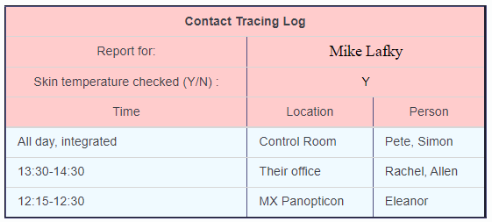
Ops Response
Each Monday run the accelerator normally for a few hours for checkout
Ops developed a machine checklist for verifying LCW, power, vacuum, etc… on days without users.
Ops developed an elog template for recording in-person interactions
Notes:
To insure we could operate on demand we’d run the accelerators normally few hours each Monday.
On days without beam Operators developed a machine checkout checklist for verifying critical systems, and ran through it every four hours.
When allowed on site for user beam operations Operators developed a standard elog template for recording in-person interactions.

Slide 10
Lessons Learned
What Didn’t Work:
Minimising operator close contacts
Hand written contact tracing
Recording names of users
What Worked:
Contact tracing elog templates
Machine checkout elog templates
great for shutdowns
PPE
Friday afternoon trivia
Notes:
So Lessons Learned.
1st what didn’t work:
Operator shifts are 12 hours long, and even with restrictions in place they were still spending at least 15 minutes in close contact over the course of a shift.
Similarly Operators weren’t good at keeping written records of interactions
What did work:
Operators developed Contact Tracing and Machine Checkout elog templates. We still use the checkout template for shutdowns.
The Victorian government made masks mandatory on worksites, and Operators had good compliance.
An operator took it upon themselves to set up a weekly trivia game, which was a big hit.

Slide 11
The Second Wave: June 2020 – October 2020

Slide 12
Daily New Cases in Victoria: 01/03-31/05
Wave 1 ends
Source: Victoria DHHS
Notes:
Our first wave ended mid-April with new cases stabilizing to approximately 10 every day.

Slide 13
Daily New Cases in Victoria: 01/03-31/10
Wave 2
Wave 1
Source: Victoria DHHS
Further Restrictions implemented
Notes:
Of course Covid didn’t end there.
The second Wave kicked off shortly after the first.
23rd July the Victorian government announced new restrictions.

Slide 14
2nd Wave Lockdown Restrictions
AS resumes 24/5 or 24/6 Operations
Ops return to work on site
Mandatory face masks
Mandatory temperature checks
More users on-site
Most staff (~2/3) continue to work from home
AS allowed to operate for:
Workers allowed on site for:
Covid research
National security research
Time sensitive research
Work essential to safety or maintenance
Supporting allowed research
Supporting future beamlines
Notes:
During the 2nd wave lockdown restrictions were slightly relaxed for the synchrotron.
In addition to covid and national security research, users with time sensitive research were allowed
And we were able to continue construction work to support future beamlines.
The synchrotron resumed its normal operating schedule and operators returned to work full time
The Victorian government required mandatory temperature screening for all worksites, including the synchrotron.
Because of the loosened restrictions on allowed research, more users and staff were on site, but most staff continued to work from home

Slide 15
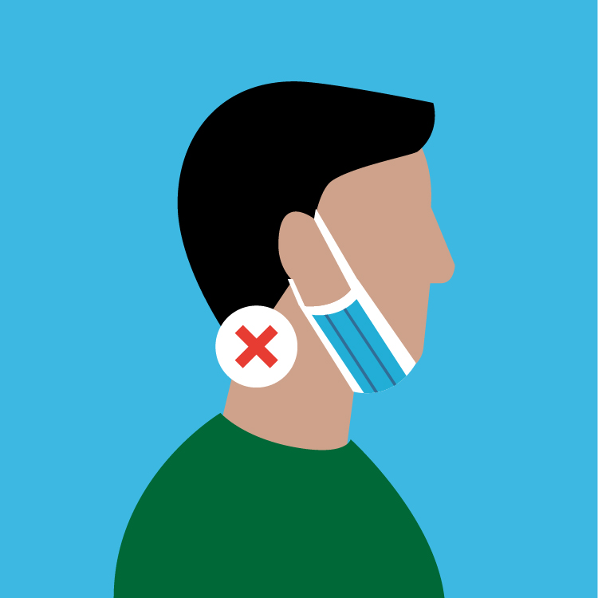
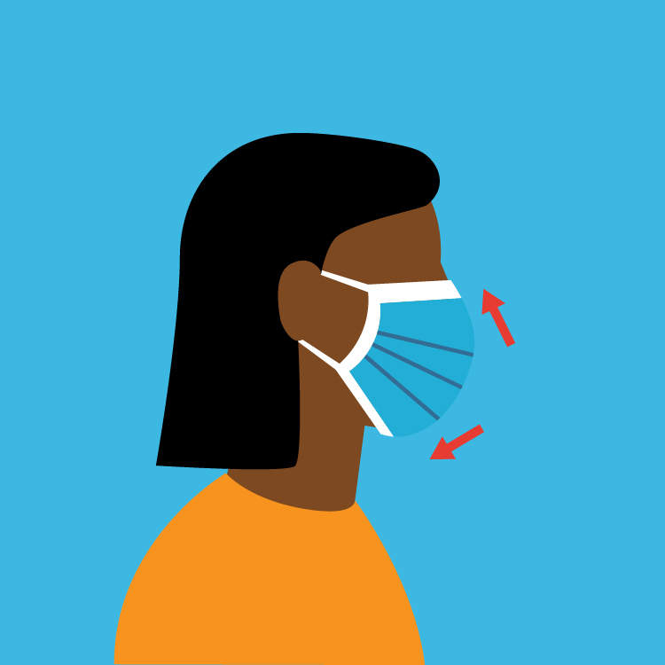
Lessons Learned
What Didn’t Work:
Social Distancing
Practically impossible to enforce
PPE (for users, construction workers)
What Worked:
PPE (for full time staff)
Notes:
What didn’t work
For Covid tracing a “close contact” constitutes two individuals being less than 1.5 m apart for 15 minutes or more. In practice it’s impossible to guarantee that two operators spend less than 15 minutes together for an entire shift.
Users and construction workers were lax about masking requirements, and had to be reminded constantly
What did work:
PPE for full time staff

Slide 16
Return to Normal(ish): November 2020 – June 2021

Slide 17
Daily New Cases in Victoria: 01/03-30/06/21
26th October, 0 new cases, 0 deaths
Wave 2
Normal(ish)
Wave 1
Notes:
Finally after two waves on 26th October 2020 Victoria records its first day since February with 0 new cases of covid and 0 deaths. Wave 2 has ended, and a sense of guarded normalcy returns to Melbourne.

Slide 18
Return to normal(ish)
Majority staff return to work on site
Interstate travel allowed, out of state users returning
Mandatory Covid testing for any cold or flu symptoms…
including users staying in the guesthouse
AS allowed to operate for:
Workers allowed on site for:
Normal research
Any work that can’t be done from home
Notes:
During this time the synchrotron was able to run normally.
Workers were allowed on site for any work that couldn’t be done remotely.
This meant for the first time since the pandemic began the majority of workers were returning to the site, and also with interstate travel restrictions eased users were coming from other Australian states.
Also during this time Victoria had strict testing requirements – anyone with cold or flu symptoms was to get a Covid test and isolate while awaiting a result – typically 24 to 48 hours.

Slide 19
Ops Response
Ops develops a procedure to assist users isolating in the guest house
Contactless assistance for moving users to quarantine rooms
Delivering food
Directing cleaners to sanitize beamline cabins, guesthouse rooms, bathrooms, etc…
Notes:
Operators developed a procedure for contactless check-in with users waiting for the results of the test.
This involved moving users to different rooms in the guest house,
delivering food,
and directing cleaners to sanitize wherever the users had been before falling ill.

Slide 20
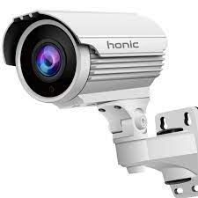
Lessons Learned
What Didn’t Work:
Elog Contact Tracing
What Worked:
CCTV Contact Tracing
Notes:
What didn’t work? The elog contact tracing template.
After practicing contact tracing for months and months, and getting the operators to consistently use it, we stopped.
Even using a standardized template requires people to remember their interactions with others, and most aren’t very good at it.
What did Work?
We ran a few training exercises and confirmed nearly 100% coverage on site with the CCTV cameras. With that those we were able to trace employee movements quickly and easily, and inform close contacts.

Slide 21
The Third Wave: July 2021 -

Slide 22
Daily New Cases in Victoria: 01/03-30/09/21
Wave 2
Normal(ish)
Wave 3
Wave 1
Notes:
From 23rd March

Slide 23
The 3rd Wave – Restrictions back
Construction continues on future beamlines
Interstate travel ban, so fewer users on site and in guesthouse
AS allowed to operate for:
Workers allowed on site for:
Covid research
National security research
Time sensitive research
Work essential to safety or maintenance
Supporting allowed research
Supporting future beamlines
Notes:
The restrictions now in place are essentially the same that we experienced during the 2nd Wave.
Construction continues on future beamlines
Interstate travel is now restricted, so most users are from Victoria or remote, so fewer staying in the guesthouse.
And that is where we are now

Slide 24
The AS’ first positive case – 23/9/21
C19+ employee attends work
Employee gets positive result
Asymptomatic Infectious Period
Thur 23/9
Fri 24/9
Sat 25/9
Sun 26/9
Mon 27/9
Tues 28/9
Wed 29/9
Public Holiday
Employee gets Covid test
Notes:
23/9 Thursday – C19+ employee attends the synchrotron
24/9 Friday – Public holiday
26/9 Sunday – Employee feels ill, gets covid test.
29/9 Wednesday – Positive result, employee informs manager

Slide 25
Actions taken Wednesday 29/9
Senior management informed. Interviews sick employee and obtains preliminary list of work locations.
Ops meets with senior management. Confirm plan to continue with operations. Security reviews footage from 23/9.
All staff email sent out.
Close contacts identified and notified.
09:30
10:30
11:30
13:30
10:15
10:40
13:00
Cleaners attend site and begin deep cleaning known locations.
Operators on duty 23/9 informed, told to get tested and isolate.
Security returns list of locations C19+ employee worked on 23/9
Notes:
09:30 Senior Management informed. Management gets preliminary list of work locations from infected staff member.
10:15 Cleaners attend site, deep clean employee’s work areas and nearby bathrooms
10:30 Ops meeting w/Senior management. Confirm plan to continue operations. Security reviewing footage for close contacts.
10:40 Day shift operators from 23/9 were told to get Covid tests and self-isolate
11:30 All staff email sent out
13:00 Security returns list of locations. Employee forgot many.
Eye witness testimony is unreliable!

Slide 26
Key Takeaways
Impossible to reduce operator contact to < 15 minutes for a 12 hour shift
CCTV is better than memory
Standardized elog templates make everything easier
Lockdown fatigue is real
Notes:
Early in the pandemic I pushed hard for social distancing, but even then it was difficult. Operators often need to assist other operators, and even for short tasks the time ads up quickly.
As mentioned elsewhere memory is unreliable and CCTV is invaluable for contact tracing.
Standardized elog templates give operators an easy script to follow.
And finally lockdown fatigue is real. We’ve all repeatedly had to push each other to continue to mask up and maintain distancing wherever possible.

Slide 27
Stats
Total number of users
 | FY19 | FY21
Victoria | 3073 (57%) | 2273 (60%)
Interstate | 1739 (33%) | 1171 (31%)
International | 519 (10%) | 349 (9%)
Totals | 5331 | 3793
~30% fewer users during the pandemic
Notes:
Finally some stats:
Ultimately the pandemic has cost us 30% of our users, almost evenly distributed across local, interstate, and international users.
In spite of this we were able to accept so many interstate and international users even during lockdown due to the remote user pipelines established on our most popular beamlines.

Slide 28
Thanks!
lafkym@ansto.gov.au

